Slide 1

SYSTEM DEVELOPMENT FOR MARKETING
RECOMMENDER SYSTEMS FOR YELP DATASET USING COLLABORATIVE FILTERING METHODS
(KNN & SVD)
David Andrew
Student No. 500903075

Slide 2
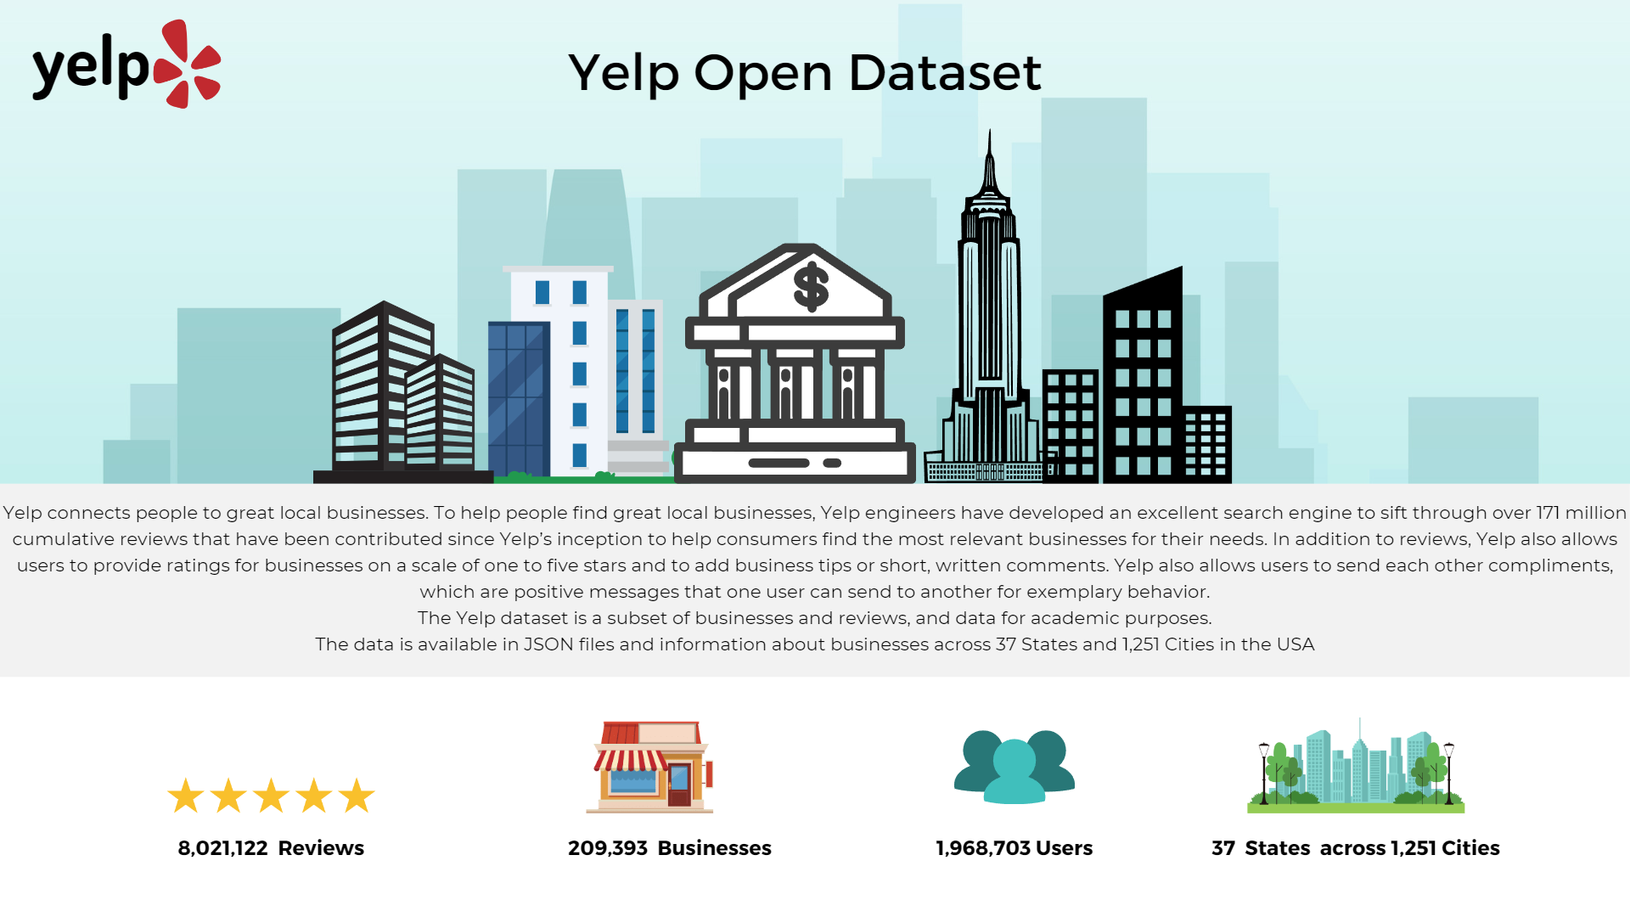

Slide 3
Business Question & Sub-questions.
“How can we utilize collaborative filtering methods to develop business recommendations for Yelp users in the top US states?”
Sub Research questions
Is there a relationship between the Number reviews and the ratings given to a business. If Yes? then to what extent does the Star ratings impact the reviews given to a business?
What are the top 10 states with the highest number of businesses on Yelp?
How effective are the KNN and SVD models on the business recommendations in Nevada?
How effective are the KNN and SVD models on the business recommendations in Arizona?
How does the choice of collaborative filtering method (KNN or SVD) impact the recommendation quality for businesses in the top 2 states?
</div>

Slide 4
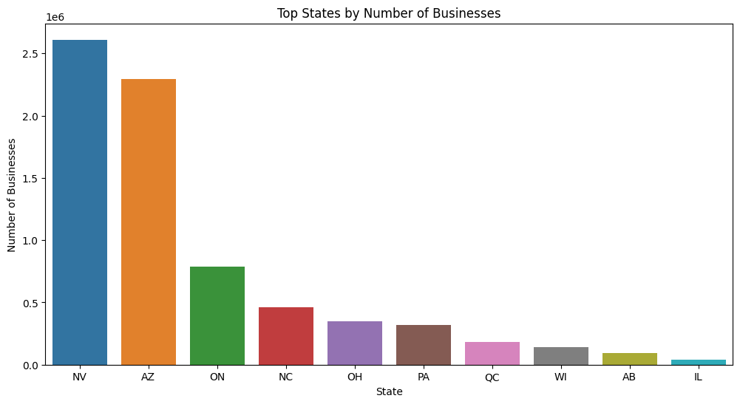
A Little Focus on the top States?
Fig. 1. This Figure Shows the states with the highest number of businesses according to yelp. (Source: Yelp Recommender code, David Andrew, 2023)

Slide 5
DATA PREPARATION & CLEANING STEPS
Loaded the ‘business’ and ‘review’ datasets from the yelp dataset.
Performed preliminary cleaning on both dataset by dropping null values and duplicates.
Created the ‘Yelp_df’ by merging the ‘business’ and ‘review’ datasets using the ‘business_id’ as the key
Further filtered the dataset by business with review counts of >= 200 and the top 2 states as discovered in the EDA. Top 2 states with the highest businesses were Nevada and Arizona.
Filtered based on active users and took a sample of 500 businesses from both the filtered Nevada and Arizona datasets.
Split the datasets into train, val and test.
Created the pivot and sparse matrices.

Slide 6
K-Nearest Neighbors Model
In this yelp project, the KNN model built in this assignment is based on the ‘user-user similarity’ which basically implies the following:
The Knn recommendation system takes user ID as an input and
Identifies k-similar users using the KNN algorithm.
It then recommends the business with the highest average rating among the top k similar users.
In this project, KNN was implemented in the following steps:
Created user-item matrix.
Created train and test set from the user-item matrix using a 80/20 split and then converted into a sparse matrix
Performed Hyperparameter tuning on the validation set to find the best combination of hyperparameters for the KNN model.
Using the best parameters to train the KNN model, I created a function called "get_user_similar_users()" to get the top 'k' similar users for a given user.
Using the similar_users() function, I create a function called "recommend_top_nevada_businesses_rmse()" to get the top 'k' business recommendations for a given user and evaluate the performance of the KNN model on the test set using RMSE as the performance metric.

Slide 7
Singular Value Decomposition Model (SVD)
The other collaborative filtering method used in this project is SVD. The SVD algorithm is used to predict user ratings for items based on their past ratings and the ratings of other users with similar preferences.
In this project, the “Surprise library” was used to implement SVD. The implementation of SVD in Surprise is based on the iterative optimization of a cost function that minimizes the difference between the predicted and actual ratings. The algorithm takes into account the sparsity of the data by using regularization techniques to avoid overfitting. The implementation also includes options for tuning hyperparameters such as the number of factors and the regularization parameter to improve the performance of the algorithm. A summary of the process is:
Training: The Surprise library uses Stochastic Gradient Descent to train the SVD model, learning user and item latent factors while also calculating biases to prevent overfitting. This process occurs iteratively over a series of epochs.
Rating Prediction: After training, the model predicts ratings for user-item pairs. It does this by calculating the dot product of the user's and item's latent factors, and adding user and item biases.
Model Evaluation: The SVD model's accuracy is assessed using the Root Mean Squared Error (RMSE) metric, which compares predicted and actual ratings
Business Recommendation: Based on the predicted ratings, the model recommends the top 10 businesses with the highest predicted ratings to users.

Slide 8
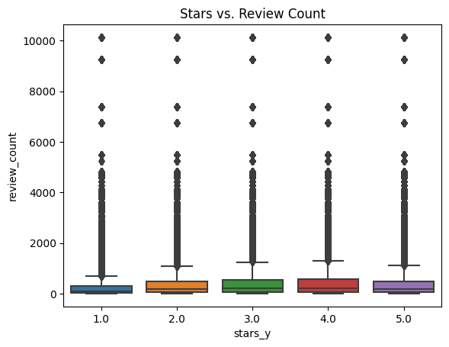
Results Analysis
Sub-question 1: Is there a relationship between the number of reviews and the ratings given to a business. If Yes? then to what extent does the Star ratings impact the reviews?
Fig. 2. Boxplot of ratings vs review count . (Source: Yelp Recommender code, David Andrew, 2023)
Businesses with a 5-star rating have a higher median review count than businesses with a 1-star rating. This suggests that businesses with a higher star rating tend to receive more reviews than businesses with a lower star rating. While the review count do not really differ much across the star ratings.
To answer the question, based on the plot, it is a little evident that there is a relationship between the reviews and the ratings, but the significance of this relationship can be tested with a simple pearson correlation To see how significant, see next results:

Slide 9
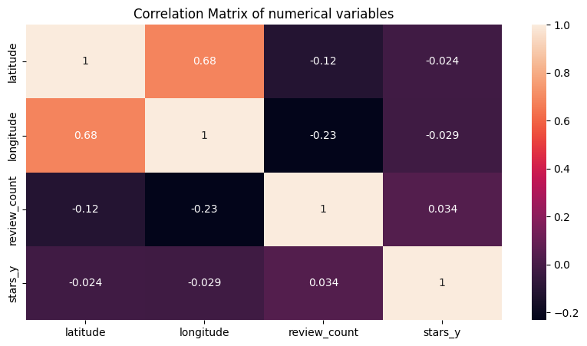
Results Analysis
The correlation coefficient is 0.03 which is very low. This shows that there is no linear correlation between the review count and the star ratings. This means that the star ratings do not have a significant impact on the review count. This is also evident from the boxplot above. The boxplot shows that the review count does not differ much across the star ratings. This means that the star ratings do not have a significant impact on the review count.
Fig. 3. Correlation table showing the ratings vs matrices relationship (Source: Yelp Recommender code, David Andrew, 2023)

Slide 10
Results Analysis
Sub-Question 3: How effective is the KNN model on the business recommendations in the top 2 states with the highest number of businesses on Yelp?
Nevada and Arizona businesses were recommended using KNN models. The KNN model was able to recommend businesses with an RMSE of 0.79 for the Nevada Businesses and 0.73 for the Arizona Businesses.
Sub-Question 4: How effective is the SVD model on the business recommendations in the top 2 states with the highest number of businesses on Yelp?
Nevada and Arizona businesses were recommended using SVD models. The SVD model was able to recommend businesses with an RMSE of RMSE: 1.2139 for the Nevada Businesses and RMSE: 1.2392 for the Arizona Businesses.This implies that, on average, the predicted ratings from the SVD model deviate from the actual ratings by approximately 1.2 units. Comparing this with the KNN model's RMSE, the SVD model has a higher level of error and lower accuracy in predicting ratings.

Slide 11
Results Analysis
Sub-Question 5: How does the choice of collaborative filtering method (KNN or SVD) impact the recommendation quality for businesses in the top 2 states?
Based on the RMSE values, it can be inferred that the KNN model performs better in terms of recommendation qualities compared to the SVD model. The lower RMSE of 0.7 suggests that the KNN model provides more accurate and reliable recommendations, indicating a better overall recommendation quality. On the other hand, the SVD model with an RMSE of 1.2 may have limitations in accurately predicting user preferences and could potentially result in less precise recommendations. The KNN model outperformed the SVD model. The RMSE of the KNN model was lower than that of the SVD model. This demonstrates that the KNN model outperforms the SVD model. It is also noteworthy to note that the SVD models generally took longer than the KNN models to compute both the models and test it. Therefore, KNN positively impacts the recommendation quality more than the SVD.
Finally, to answer the main business question 'How can we utilize collaborative filtering methods to develop business recommendations for Yelp users in the top US states?, The KNN model is more resilient than the SVD model. This is due to the fact that the KNN model makes no assumptions about the underlying data distribution. The SVD model requires normally distributed data. The KNN model is also easier to understand than the SVD model. This is how easy the KNN model can be conveyed to non-technical persons. Non-technical persons will struggle to understand the SVD model. In addition, the KNN model is more scalable than the SVD model. This is because the KNN model does not require any training. The SVD model requires training. The KNN model is also more flexible than the SVD model. It is also noteworthy to note that the SVD models generally took longer than the KNN models to compute both the models and test it.
In conclusion, it is important to note that other factors such as data quality, scalability, and specific application requirements should also be considered when evaluating and choosing the most suitable recommender model for a given scenario.

Slide 12
Github
https://github.com/Kingdavie95/Yelp-Recommender-System-Using-Collaborative-Filtering-KNN-SVD-
Dataset

